Slide 1
Big data architectures for Machine Learning and Data Mining
Apache Spark
Sagar Nagaraj Simha
Matrikel Number - 120797, sagar.nagaraj.simha@uni-weimar.de
Master’s Computer Science for Digital Media - SS2019
Bauhaus University Weimar

Slide 2
What is Apache Spark?
A unified computing engine and a set of libraries for parallel data processing on computer clusters

Slide 3
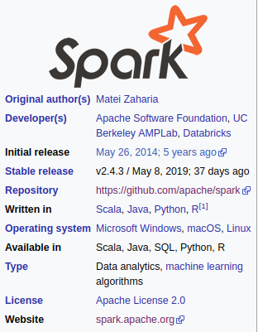
Origin

Slide 4
Why develop Apache Spark?

Slide 5
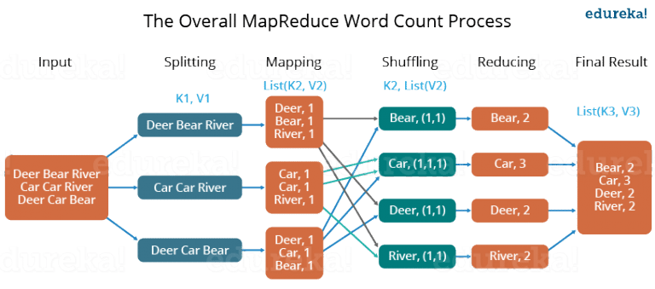
Image courtesy [7]

Slide 6
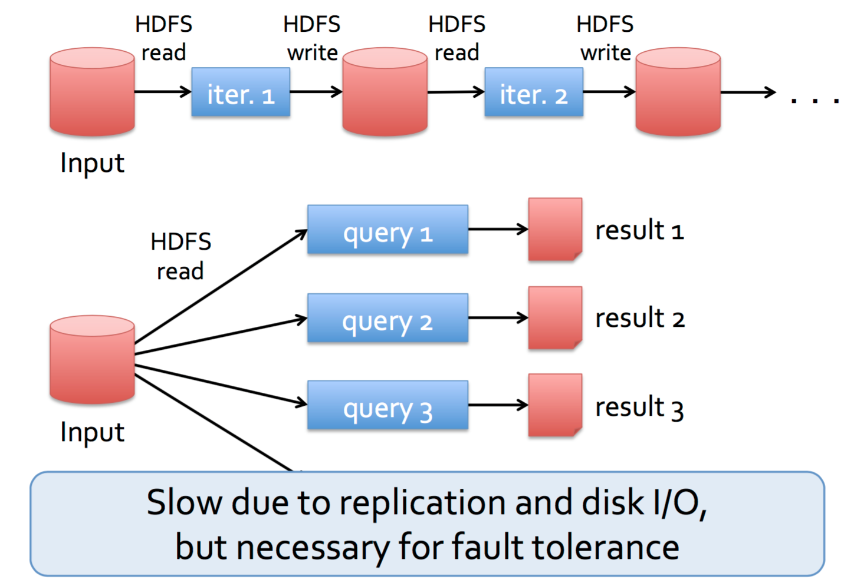
Apache Hadoop-MapReduce
Data moving over network in Hadoop is slow

Slide 7
Apache Hadoop-MapReduce
MapReduce is inefficient for multi-pass and low latency requirement applications
Iterative algorithms
Interactive data mining
Streaming applications
Hadoop included the Hadoop file system and MapReduce.
Hard to run one of the systems without the other
Incompatible with other cloud storage services

Slide 8
Challenges
Incorporate the previously mentioned features
Have a distributed memory abstraction
Fault tolerant and efficient

Slide 9
Apache Spark’s Philosophy
“A new engine and programming model for data analytics”
Unified
Combines batch, interactive and streaming (incremental processing)
Computing Engine
Supports HDFS, Cassandra, Kafka etc and focuses on Computing - Moving data is expensive.
Libraries
Spark SQL - SQL and structured data
MLlib - Machine learning
GraphX - Graph analytics
Spark Streaming and the newer Structured Streaming - Stream processing
Many others on https://spark-packages.org/ (Ex: Connectors to cloud storages, ML algorithms etc)
Resilient Distributed Datasets at the Lowest level for efficient fault tolerance

Slide 10
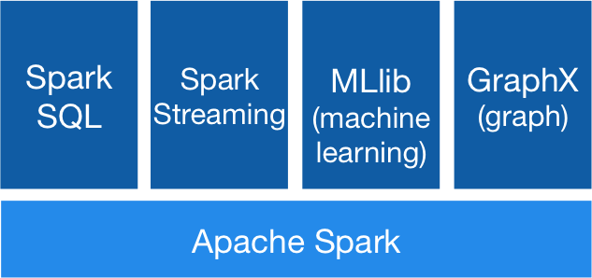
The Stack

Slide 11
Resilient Distributed Datasets (RDDs)

Slide 12
Apache Hadoop-MapReduce

Slide 13
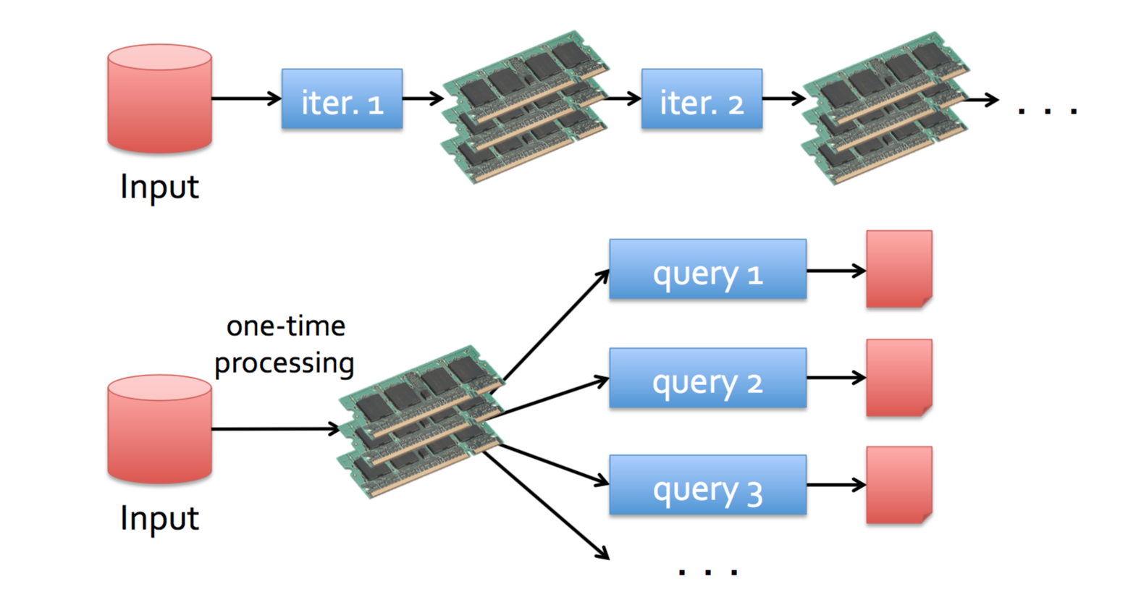
Spark - In Memory Data Sharing using RDDs
10-100x faster than data write over the network

Slide 14
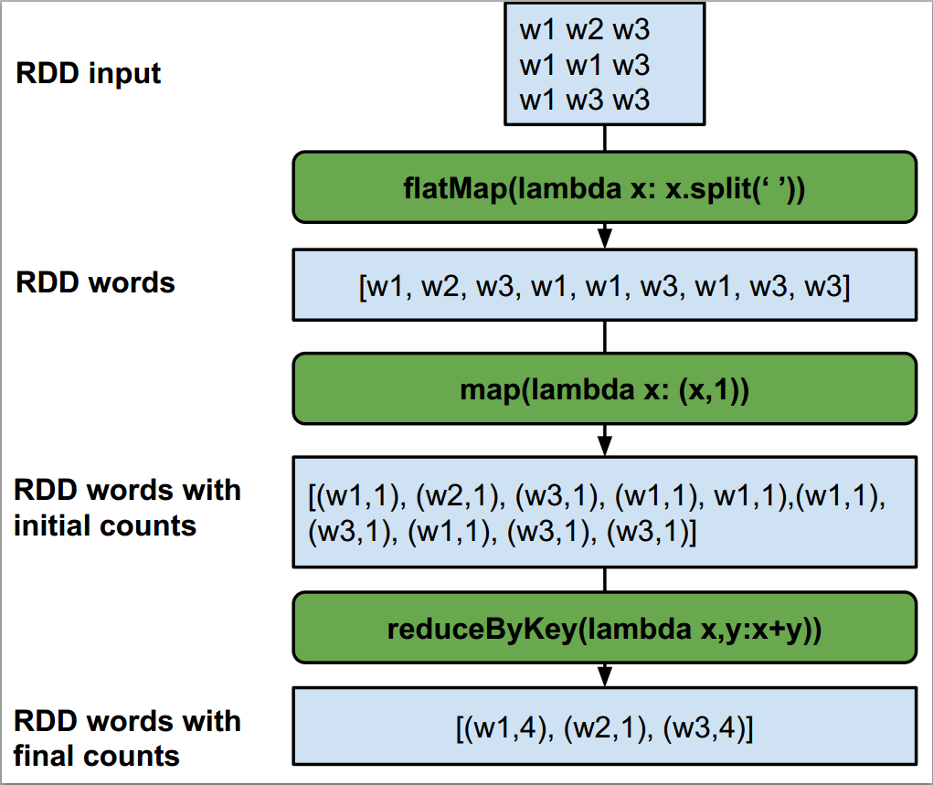
Fault Recovery
RDDs track the graph of transformations that built them (their lineage - map, filter, join etc…) to rebuild lost data
Each row in the RDD input is a partition stored in a different machine in the cluster
The transformations (in green box) are applied to each partition
A batch data (blue box) may be recovered by running the corresponding transformation that produced it

Slide 15
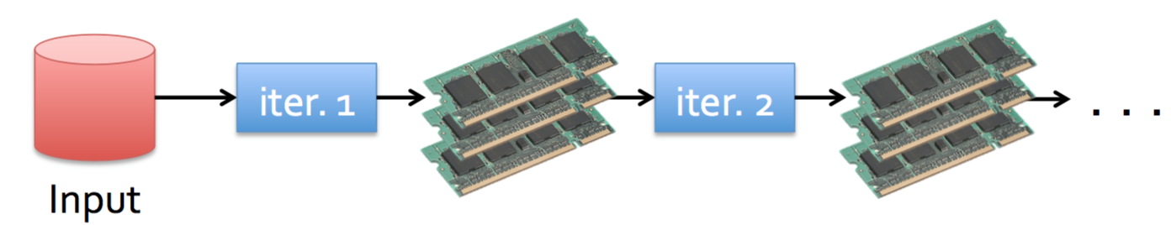

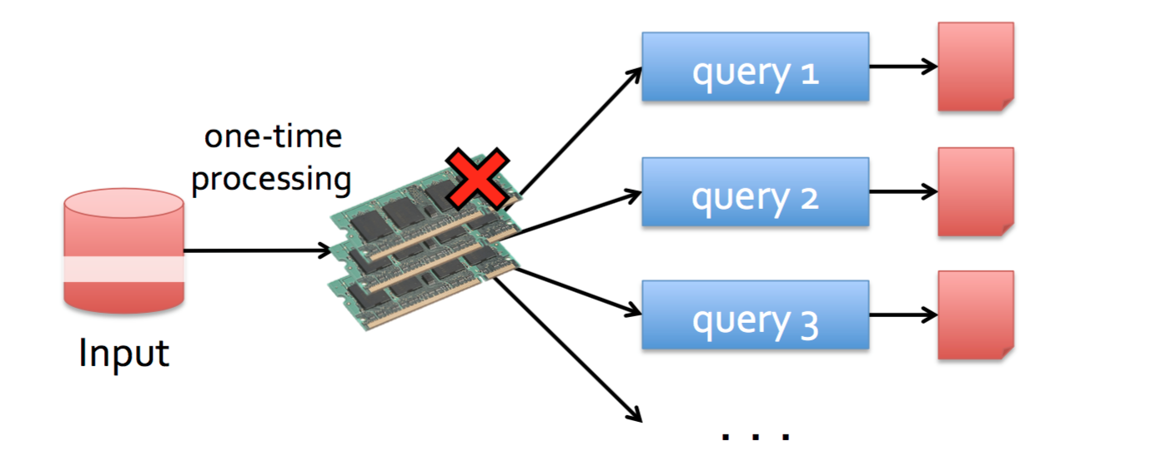
RDD Recovery - Fault Tolerance
Persistence

Slide 16
RDD Recovery - Fault Tolerance
Persistence

Slide 17
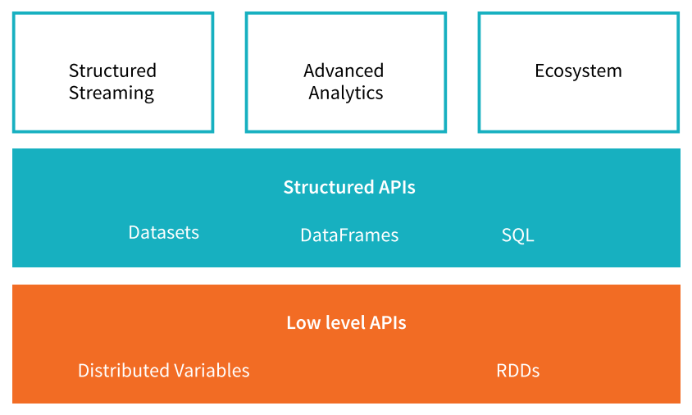
What Spark offers

Slide 18
Architecture and workflow

Slide 19
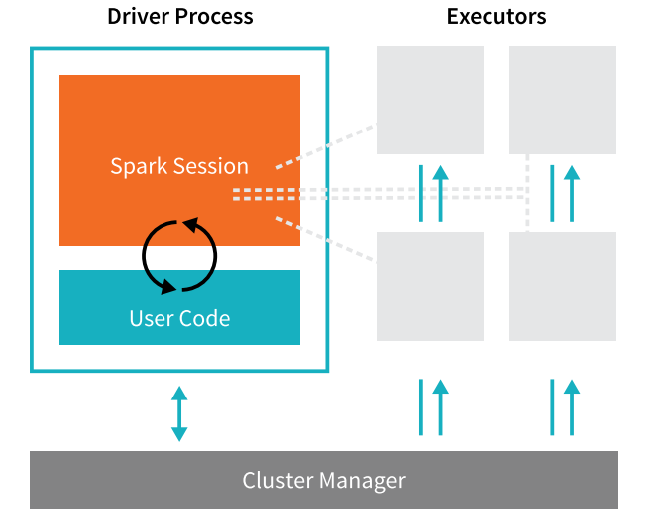
Apache Spark architecture and workflow

Slide 20
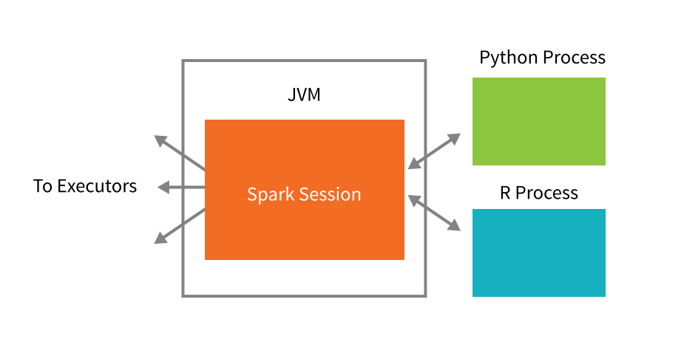
Scala, Python & R hooks to launch a Spark Session

Slide 21
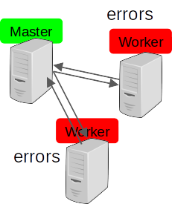
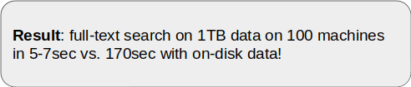
Spark Example: Log Mining
Load error messages from a log into memory and run interactive queries
lines = spark.textFile("hdfs://...")
errors = lines.filter(startsWith("ERROR"))
errors.persist()
errors.filter("404" in errors).count()
errors.filter(“405” in errors).count()

Slide 22
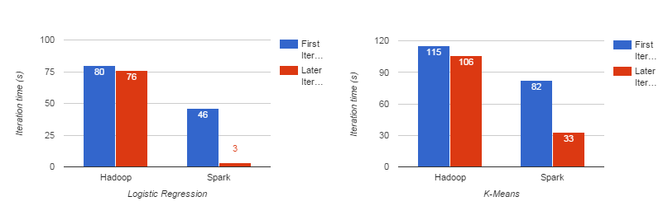
Performance - 10 iterations on 100GB data using 25-100 machines

Slide 23
Features/Advantages
Open-source
Speed - 100x faster than Hadoop for large scale data processing
Automatic fault tolerance
Unified Engine
Usability with multiple languages
Lazy Evaluation - “predicate pushdown”
Compatibility with other ecosystems
Supports interactive and production applications
Easy-to-use APIs for operating on large datasets

Slide 24
Companies/Products that use Spark
Amazon
Uber
Baidu
eBay Inc.
Using Spark core for log transaction aggregation and analytics
Yandex
PanTera
PanTera is a tool for exploring large datasets. It uses Spark to create XY and geographic scatterplots from millions to billions of datapoints.
Vistar Media
Location technology company enabling brands to reach on-the-go consumers

Slide 25
Research institutions that use Spark
CERN Open Lab
From Collision to Discovery: Physics Analysis with Apache Spark
European Gravitational Observatory
Machine Learning for Gravitational Wave signals classification in LIGO and Virgo
Freeman Lab at HHMI
We are using Spark for analyzing and visualizing patterns in large-scale recordings of brain activity in real time
NASA JPL - Deep Space Network
Stanford DAWN
Research lab on infrastructure for usable machine learning, with multiple research projects that run over or accelerate Apache Spark.

Slide 26
Installation

Slide 27
For the Demo, we will run a Hadoop Compatible Apache Spark on a Vagrant VM machine with a driver(master) node and N(2) worker nodes

Slide 28
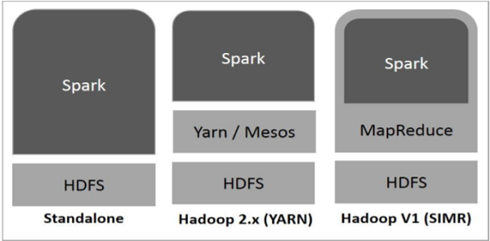
Apache Spark with other systems
We will use Apache Spark Standalone Cluster manager for demo

Slide 29
Apache Spark with other systems
Over Hadoop YARN Cluster,
https://www.linode.com/docs/databases/hadoop/install-configure-run-spark-on-top-of-hadoop-yarn-cluster/
https://databricks.com/blog/2014/01/21/spark-and-hadoop.html
http://www.datumly.com/2017/08/apache-spark-2-2-in-a-virtual-machine-simple-getting-started-guide-to-run-spark-on-your-laptop/
https://medium.com/explore-artificial-intelligence/downloading-spark-and-getting-started-with-python-notebooks-jupyter-locally-on-a-single-computer-98a76236f8c1
With Hadoop:
https://www.davidadrian.cc/posts/2017/08/how-to-spark-cluster/
With Jupyter Notebook:
https://opensource.com/article/18/11/pyspark-jupyter-notebook

Slide 30
DEMOS

Slide 31
Demo plan
Launching the VM cluster with Spark
Spark UI
Spark Shell (PySpark)
Features of Spark - RDDs, DataFrames, Lazy Evaluation
Flight Data Analysis
Word Count
Production Application - Calculation of Pi

Slide 32
Disadvantages
No File Management System (Reliant on other storage)
In-memory computations are expensive
Spark MLlib has limited algorithms
Manual Optimization
Lower latency compared to Apache Flink

Slide 33
Research in Spark
https://spark.apache.org/research.html
Spark Summit - https://databricks.com/sparkaisummit

Slide 34
To deep dive further
A-Gentle-Introduction-to-Apache-Spark (Databricks)
Spark - The Definitive Guide - Big data processing made simple (O’Reilly)
Learning Spark, Lightning-Fast Big Data Analysis (O’Reilly)

Slide 35
Dataset Used for Demo
https://github.com/databricks/Spark-The-Definitive-Guide/tree/master/data

Slide 36
References
[1] https://www.youtube.com/watch?v=dXG4yC8ICEI
[2] https://spark.apache.org/research.html
[3] https://www.whizlabs.com/blog/apache-spark-limitations/
[4] https://spark.apache.org/powered-by.html
[5] https://www.youtube.com/watch?v=L029ZNBG7bk&feature=youtu.be
[6] A Gentle Introduction to Apache Spark - By Databricks
[7] https://www.edureka.co/blog/mapreduce-tutorial/

Slide 37
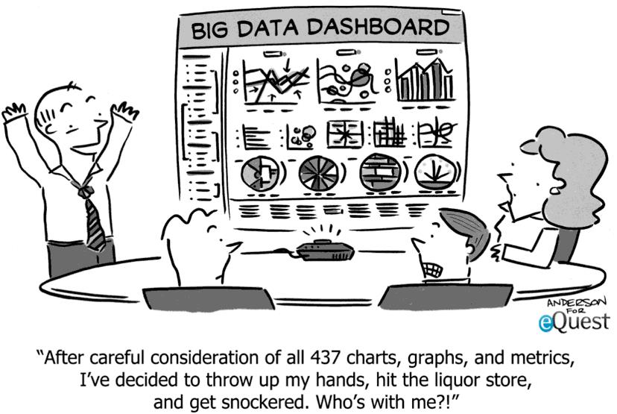
Vielen Dank!

